Slide 1
Easier reproducibility for scientists with encapsulation

Slide 2
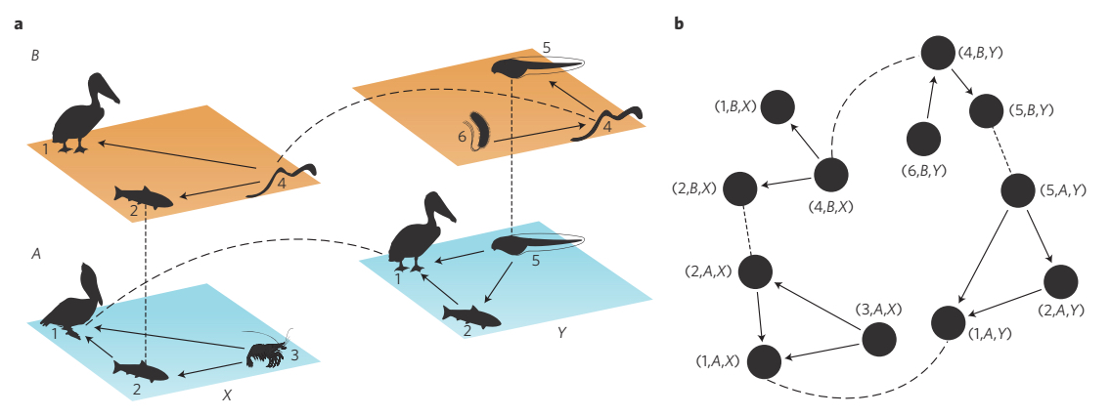
Notes:
I’m a quantitative ecologist, and so I spend most of my time thinking about ecosystems and how to analyze them. And over the years, my software needs have far outpaced commercial development.

Slide 3
Software should not limit science.
Notes:
So, I have been a open-source analytical software developer, educator and advocate for nearly 10 years.

Slide 4
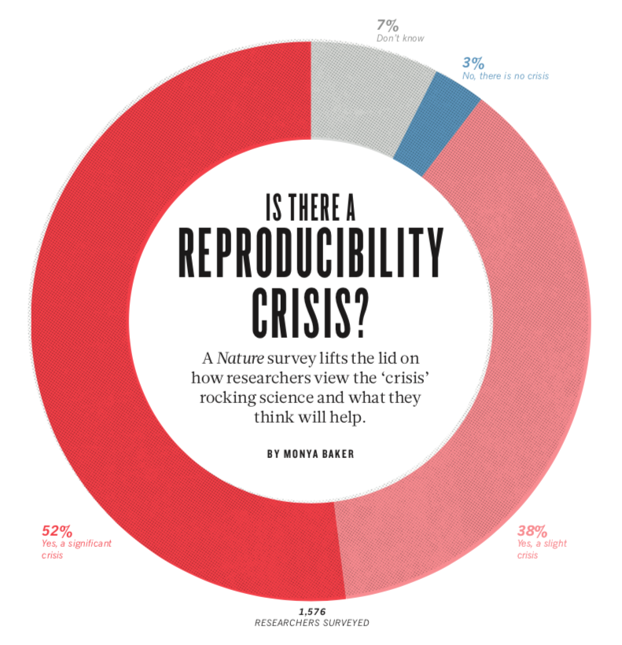
Notes:
A couple years ago, I, like many other scientists, was troubled by the “expose” on scientific reproducibility (or ir-reproducibility) that apparently was abundant across all of science.

Slide 5
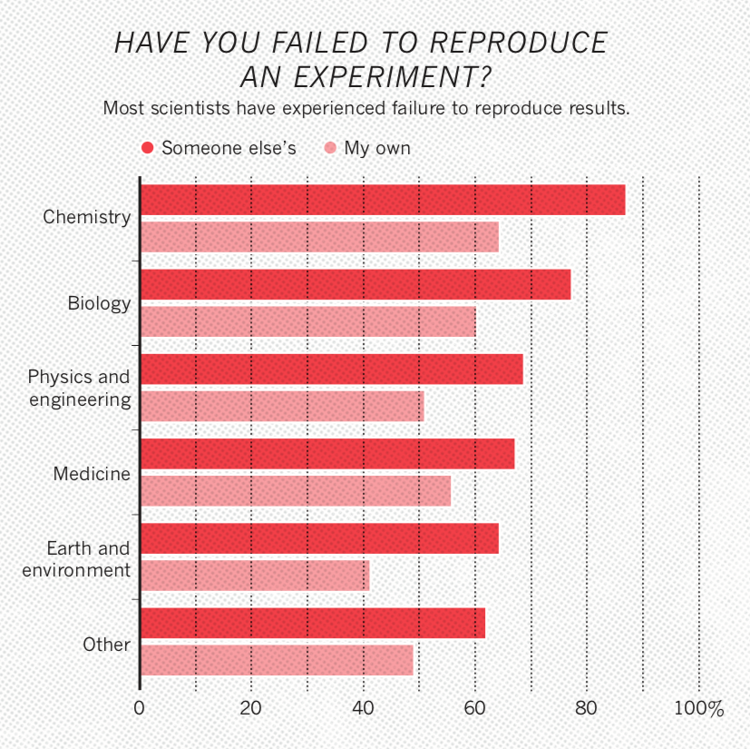
Notes:
Biology was particularly troubled, according to the results, and I would assume that ecology would on the more troubled edge of the spectrum given the typically small sample sizes and highly complex, multivariate systems studied.

Slide 6
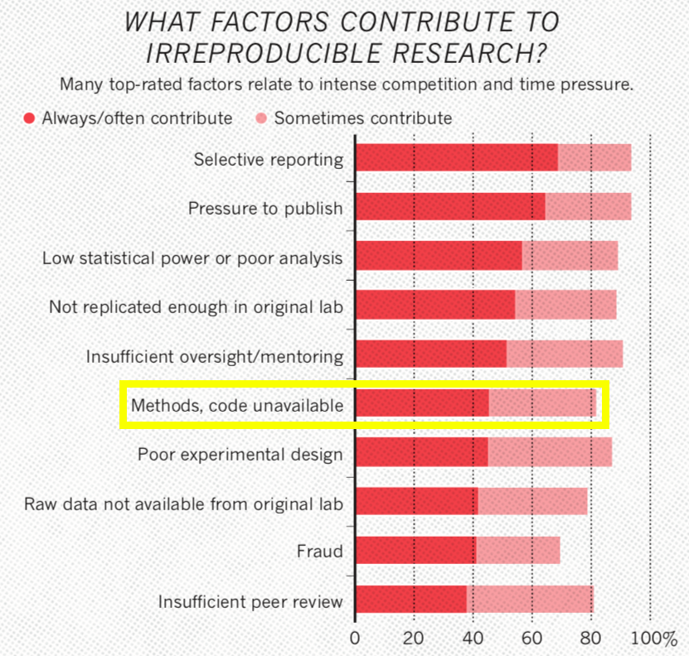
Notes:
Not surprisingly, though not at the forefront of my thinking, code was mentioned as a major issue.

Slide 7

Notes:
This should not have been surprising given my experience with analytical software, my own, my students and my colleagues.

Slide 8

Notes:
Beautiful unique snowflakes of code as intricate and awkward as a rube goldberg machine.

Slide 9
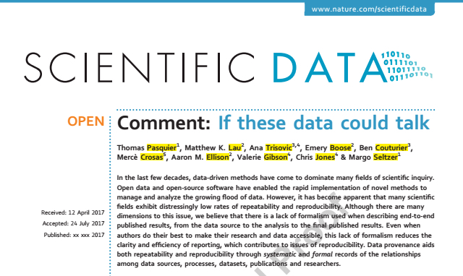
Notes:
So, in collaboration with folks at CERN, University of Cambridge and Mt Holyoke, we wrote a paper highlighting important issues.

Slide 10
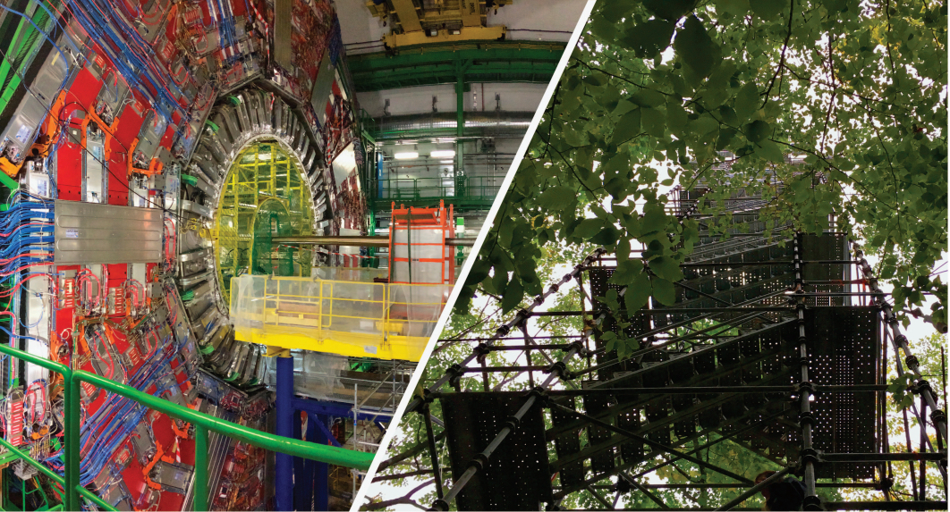
Notes:
The main thrust being, the sciences (whether particle physics or ecosystem ecology) have rapidly become computationally intensive. and given the constraints placed on most domain scientists, they want to do their work, not spend seemingly extra time refactoring code that has already produced results (i.e. if it’s not broke, you don’t have time to fix it).

Slide 11
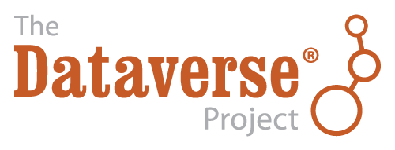

Slide 12
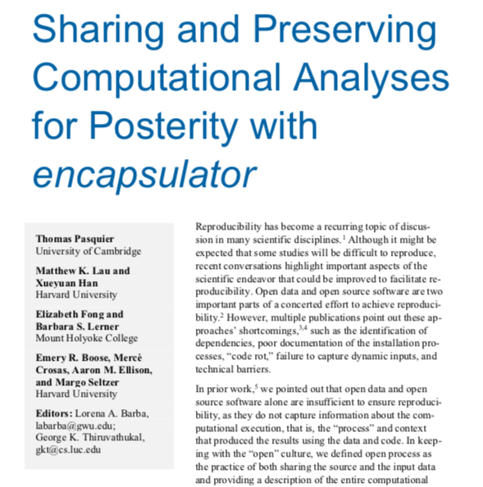
IEEE: Computing in Science & Engineering 2018
Notes:
In collaboration with Mt Holyoke and the other Cambridge, we developed a tool to conduct encapsulation.

Slide 13
Encapsulator
Purpose: Simplify computational reproducibility
Create a data “capsule” (code + data + environment)
Increase transparency with “cleaned” code

Slide 14
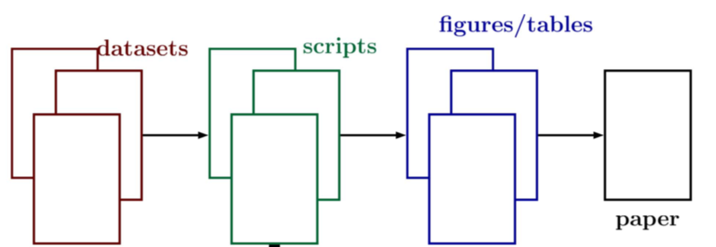
Notes:
Basic workflow from data to publication.

Slide 15
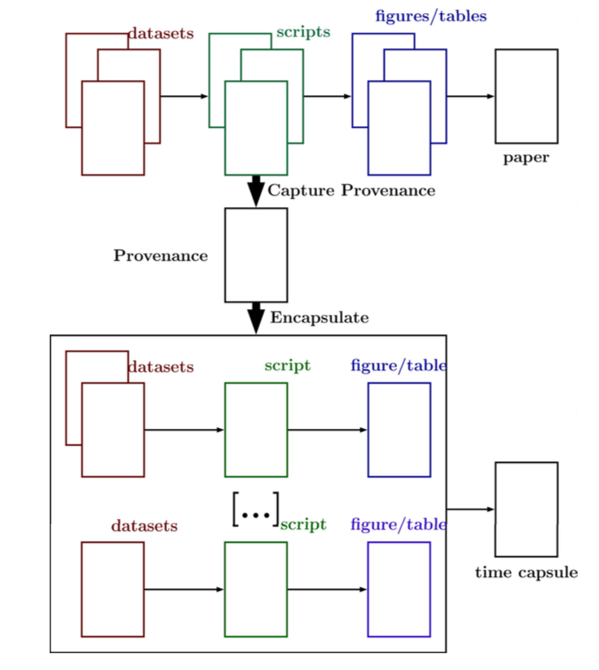
Notes:
Encapsulation creates a “capsule” based on a set of results (likely a subset) using data provenance.

Slide 16
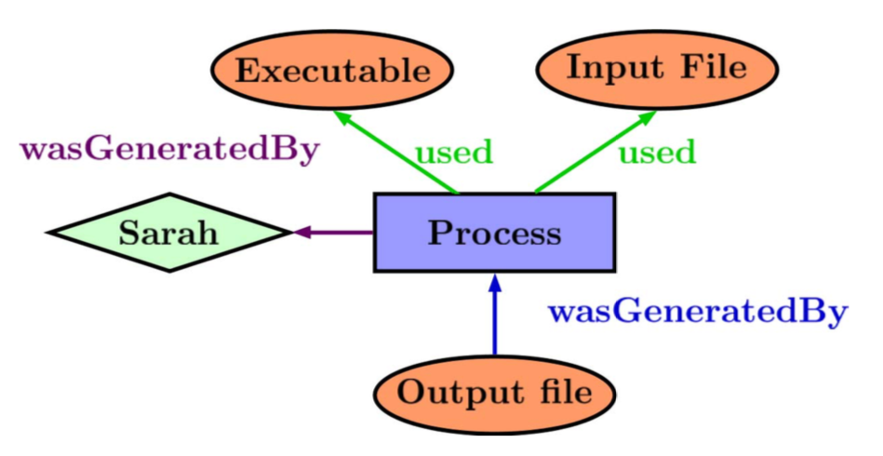
What is data provenance?
Notes:
Data provenance is a formal representation of a computational process that produced a result.

Slide 17
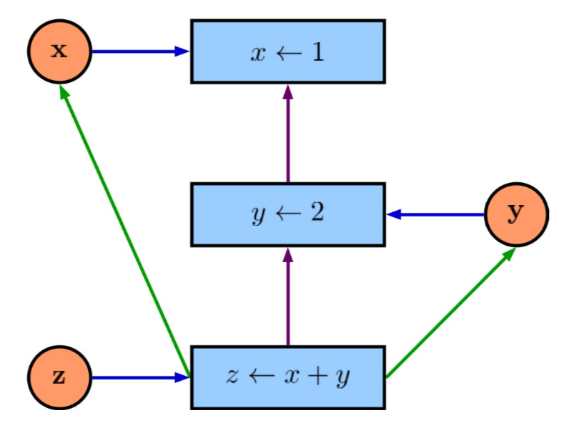
What is data provenance?
Notes:
Here’s a simple example

Slide 18
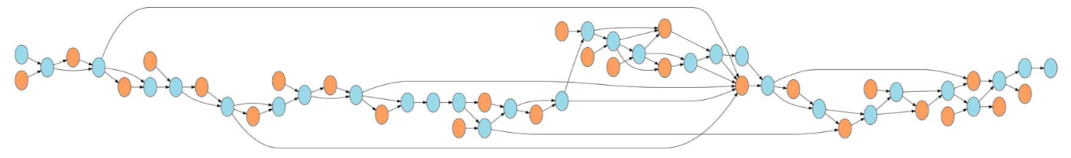
Prov. Huh. What is it good for?
Notes:
For more complex analytical pipelines, provenance is a formal way to deal with the tangle of processes and data

Slide 19
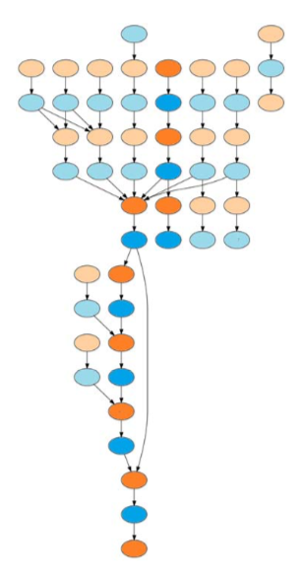
Notes:
Data provenance is used by encapsulator to 1) clean code by finding the essential code pathway, 2) locate and re-organize pathways and 3) get environment details (e.g. libraries).

Slide 20
Challenges
Out-of-tree Libraries
Nondeterminism
Capsule OS (Linux, VirtualBox)
Language Support (R)
More effective “code cleaning” (Rclean)
Notes:
Coe cleaning: e.g. How to handle control statements.

Slide 21
Future Directions
Test Dataverse products
Integration with IDEs (RStudio)
Container Support (e.g. Docker)
Domain-Specific Environments
Email: matthewklau@fas.harvard.edu
Github: MKLau
This work was supported by NSF grants SSI-1450277 (End-to-End Provenance) and ACI-1448123 (Citation++).
More details about those projects are available at https://projects.iq.harvard.edu/provenance-at-harvard.

